Slide 1
Chilterns Tunnel Vent Shafts

Slide 2
Contents
Vn 1.0 3-Jan-2015
Slide Subject
3,4 Little Missenden
5,6 Amersham
7,8 Chalfont St Giles
9,10 Chalfont St Peter

Slide 3
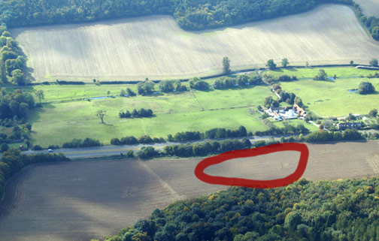
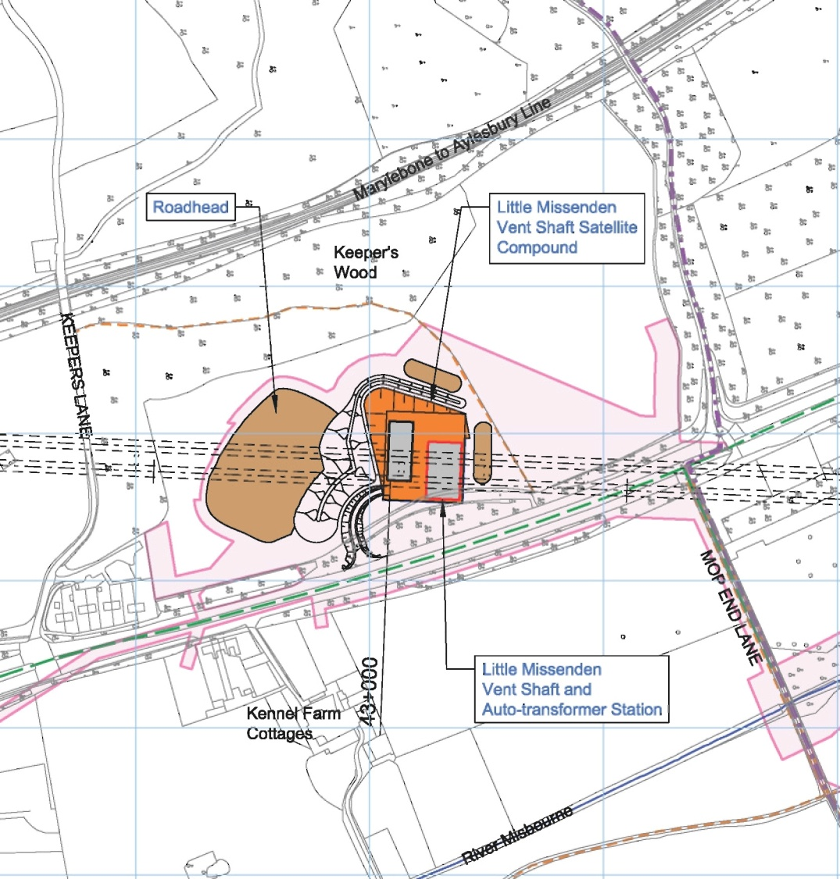
Little Missenden
The Little Missenden vent shaft is ajacent to the A413. Moving the roadhead and entrance to the other side of the compound would reduce the impact on nearby accomodation – although this would be nearer to Shardellos Walled Garden

Slide 4
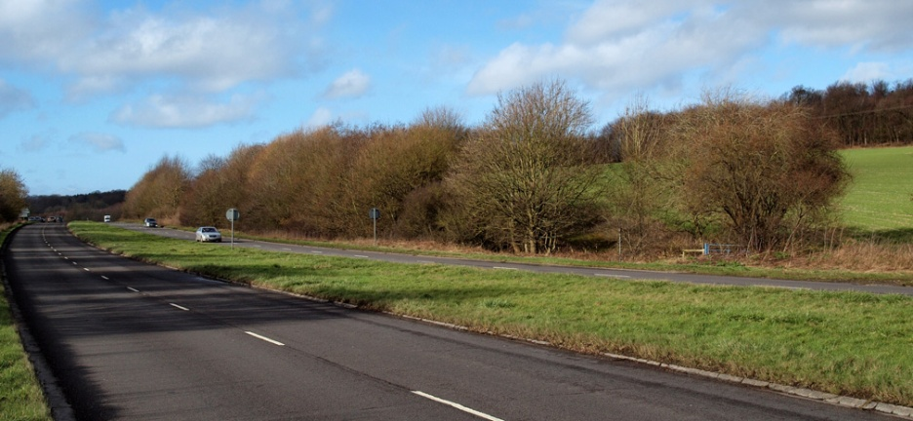
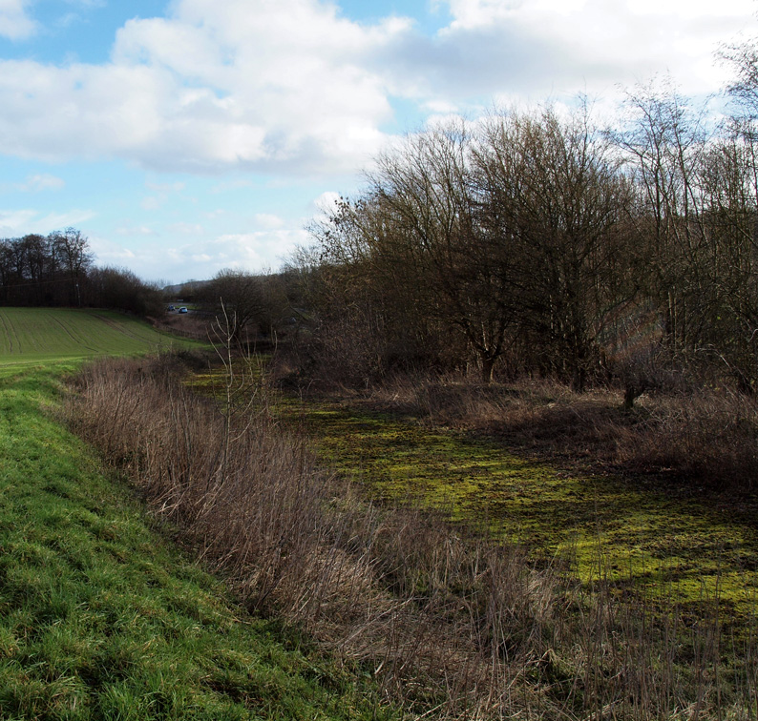
Little Missenden
The site is screened by an existing hedgerow, behind which is a section of the old A413.
Cutting an access road through the hedge is typical of the lack of thought given to planning this project.

Slide 5
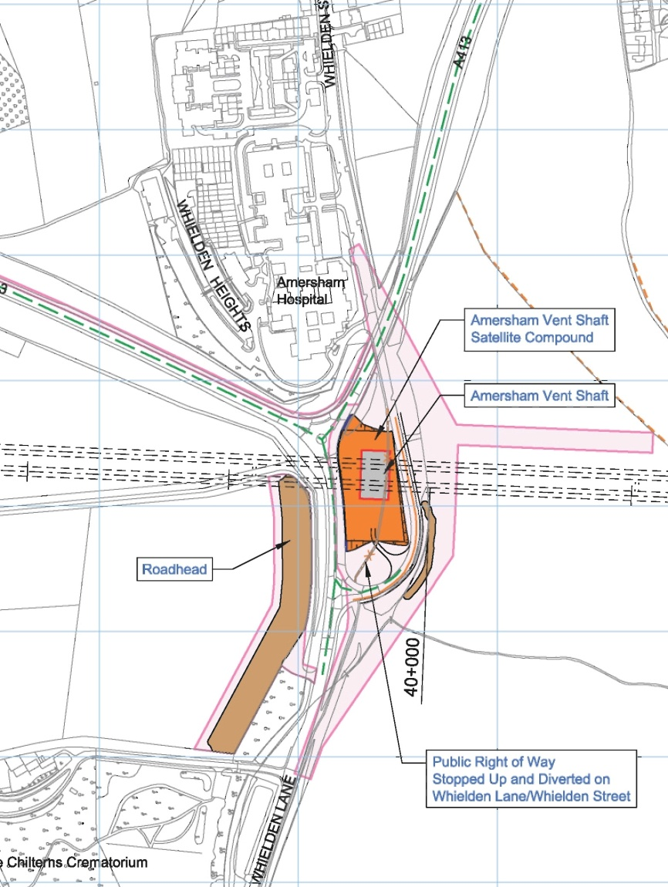
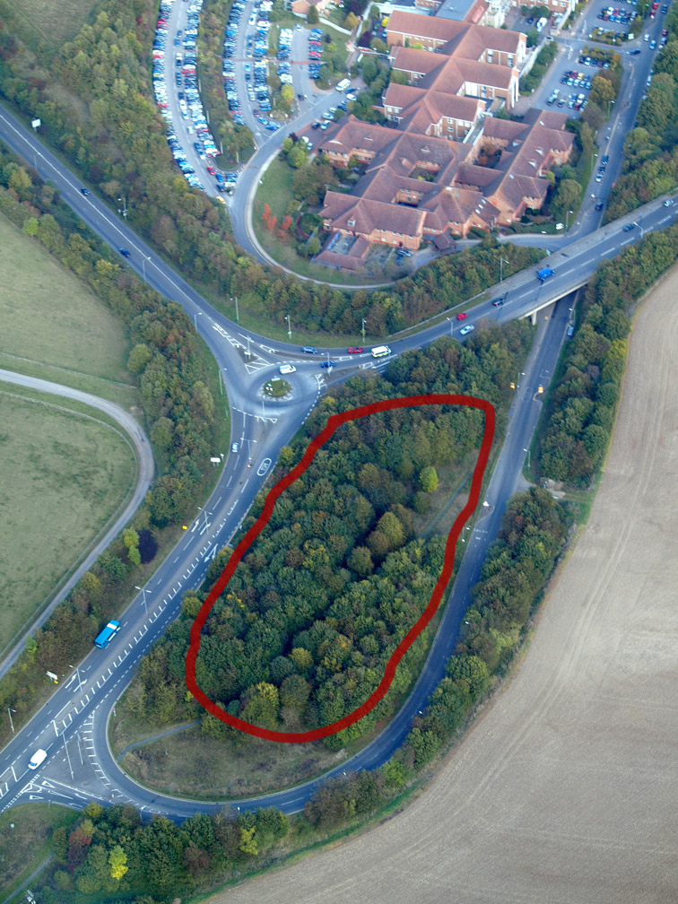
Amersham Vent Shaft
Situated on a traffic island, next to Amersham Hospital, with the roadhead on the far side of the A404. Another planning masterstroke …
Notes:
Needs a bus map showing routes to the hospital !

Slide 6
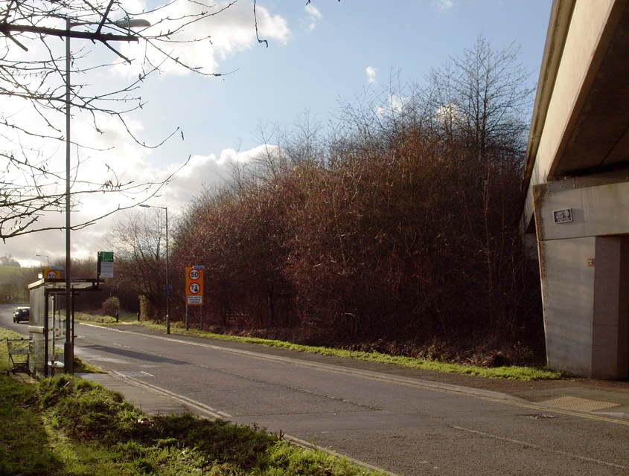
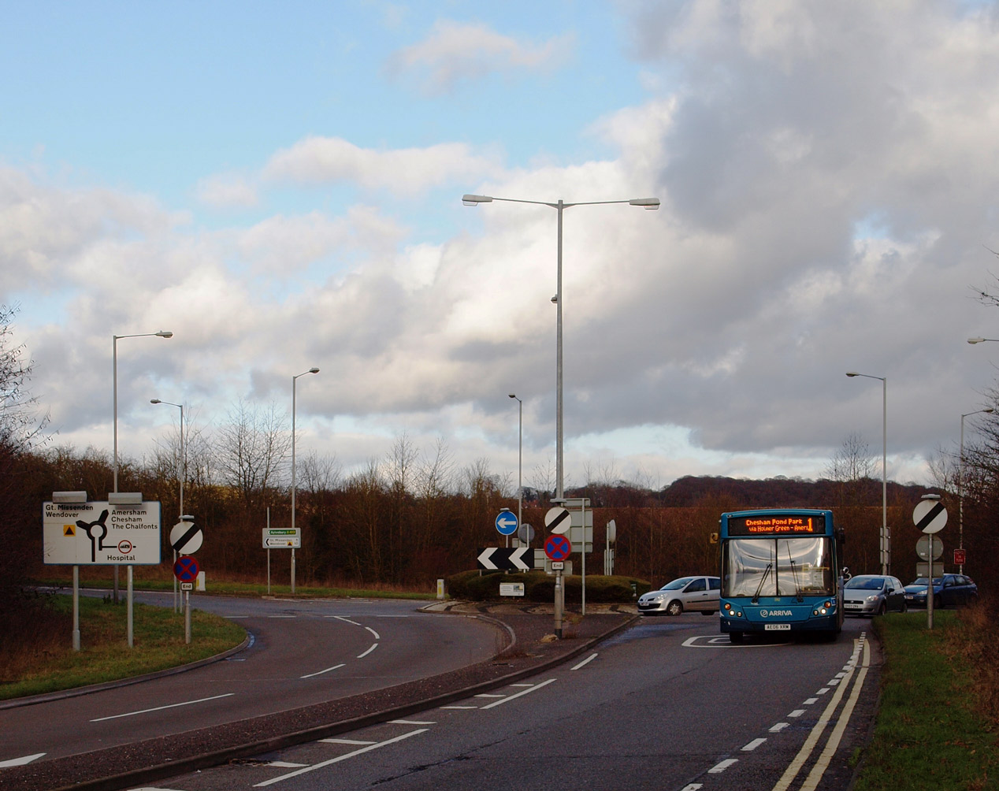
Amersham Vent Shaft
The site is constrained on two sides by the A413 and A404, both HS2 construction routes. The entrance to the Chilterns Crematorium is a few hundred yards
down the A404.
On the third side, Whielden Street is the access route to
Amersham Hospital for NN bus services, and to the hospital car parks.

Slide 7
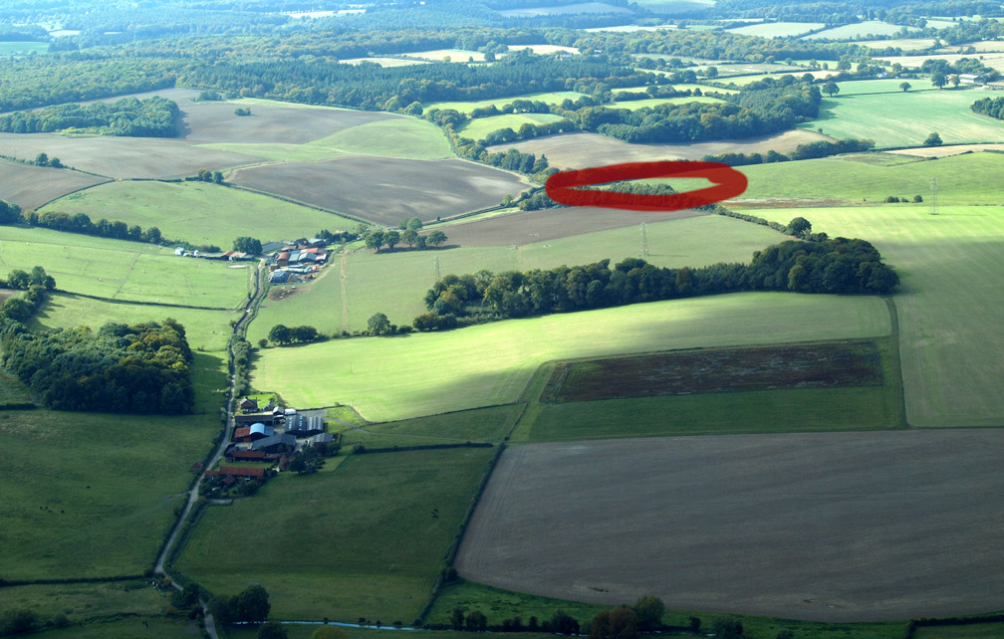
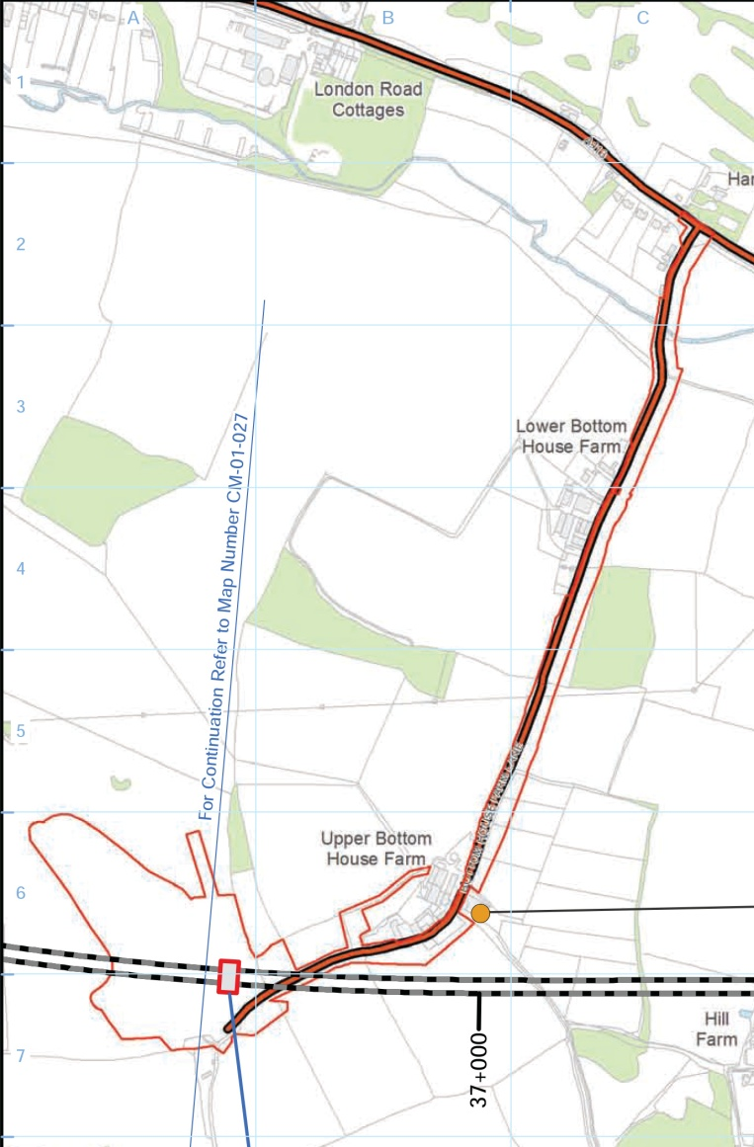
Chalfont St Giles Vent Shaft
The Chalfont St Giles shaft is situated where the tunnel passes under Bottom House Farm Lane. Presumably this was thought to provide a suitable access route for HGV traffic, but this is not the case.

Slide 8
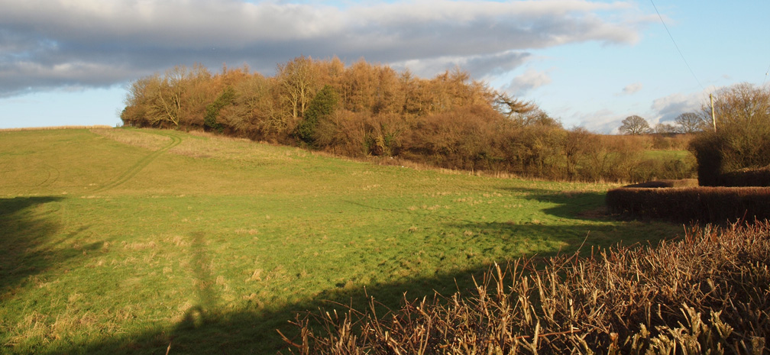
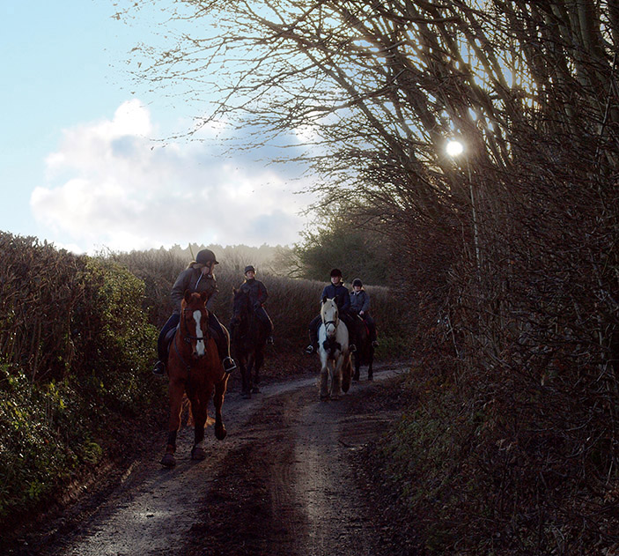
Chalfont St Giles Vent Shaft
The proposed scheme calls for
permanent widening of Bottom House Farm Lane generally along the south side, to achieve a 4m wide road…
strips of planting on both sides of the widened Bottom House Farm Lane to replace the existing hedgerows along the road
Clearly the lane constitutes an obstacle to the construction of an access road.
A new road from the North side of the compond, joining the A413 (and crossing the Misbourne) at the London Road depot would preserve the Lane, and quite possibly be cheaper – since the expense of grubbing out the existing hedgerows would be avoided

Slide 9
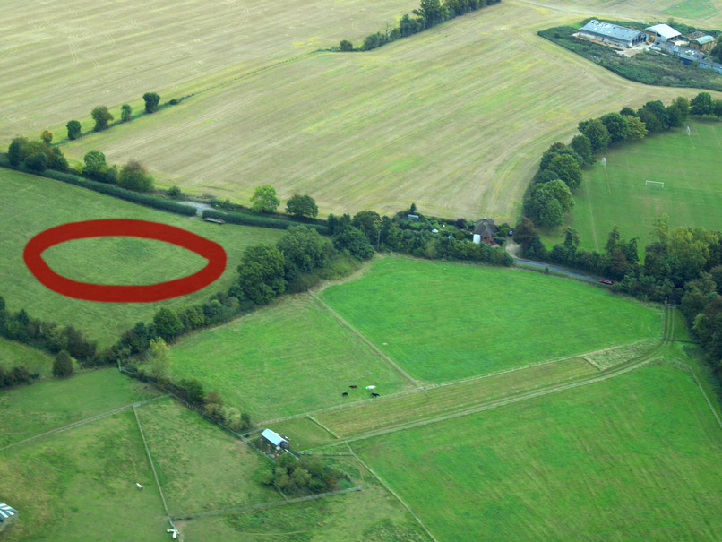
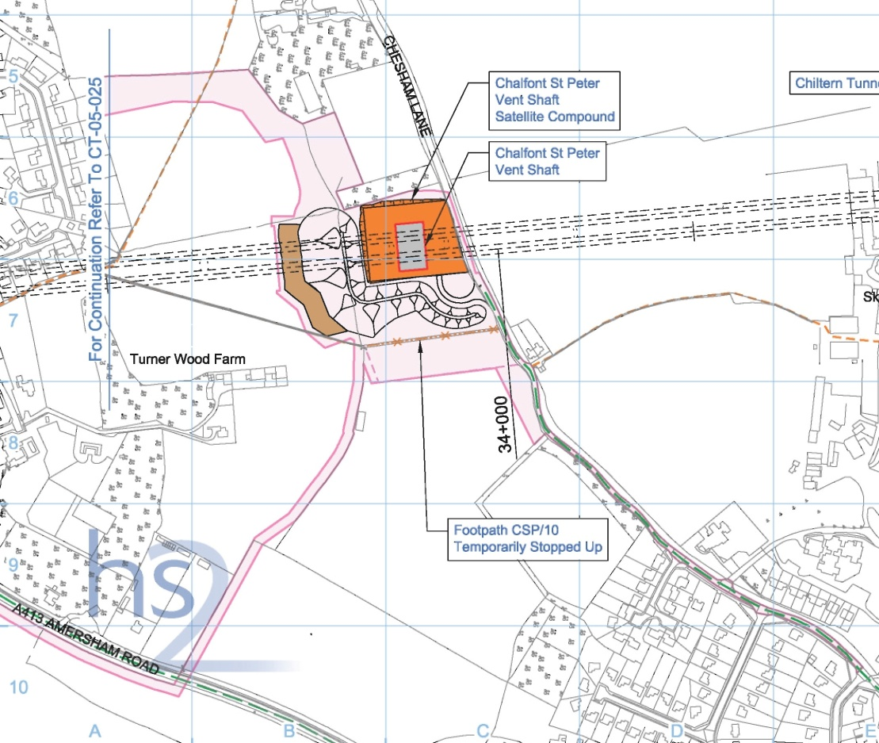
Chalfont St Peter Vent Shaft
While the site is only 300m from the A413, HS2 have proposed a 2 mile route along residential roads through Chalfont St Peter.

Slide 10
Chalfont St Peter Vent Shaft
Need some pictures !

